Slide 1
GSERM: Text Mining & NLP TM Basics
Ted Kwartler

Slide 2
Agenda – all times are suggested
Start | End | Monday
8:45 | 9:15 | Coffee
9:15 | 10:15 | Syllabus, Intro to R, R Setup
10:15 | 10:30 | Break
10:30 | 12:00 | What is TM? String Manipulation Keyword Search & Density Misspelling
12:00 | 1:30 | Lunch
1:30 | 2:00 | Bag of Words tm Class & Functions Meta-Document Information
2:00 | 2:30 | WFM
2:30 | 3:15 | Lab: Clean a corpus of tweets & construct WFM

Slide 3
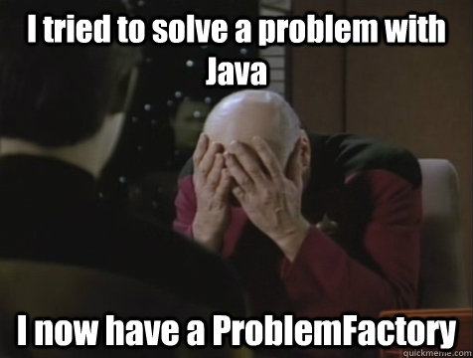
Mo’ Packages Mo’ Problems
install.packages(“qdap”)
QDAP requires JAVA…so if you don’t have Java it won’t install.
install.packages(“tidytext”)
Tidytext is a “tidyverse” package, works in tibbles and with “%>%” so it’s a bit confusing for new R programmers.

Slide 4
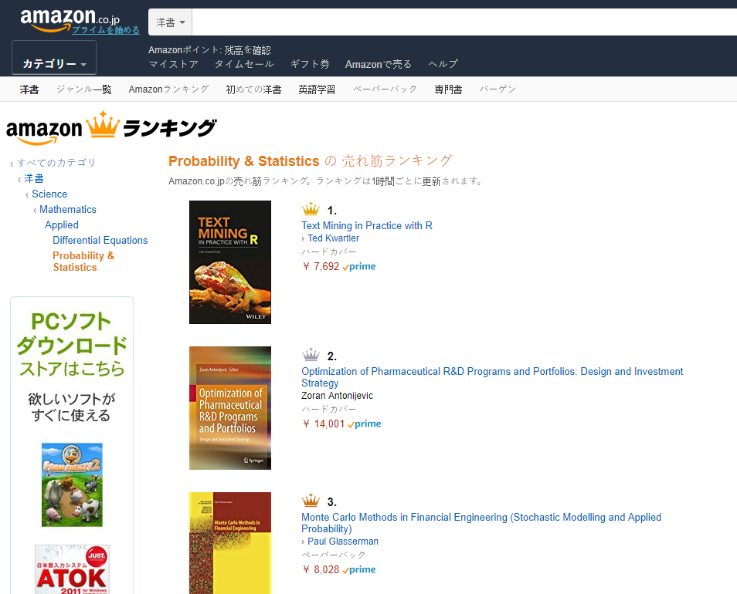

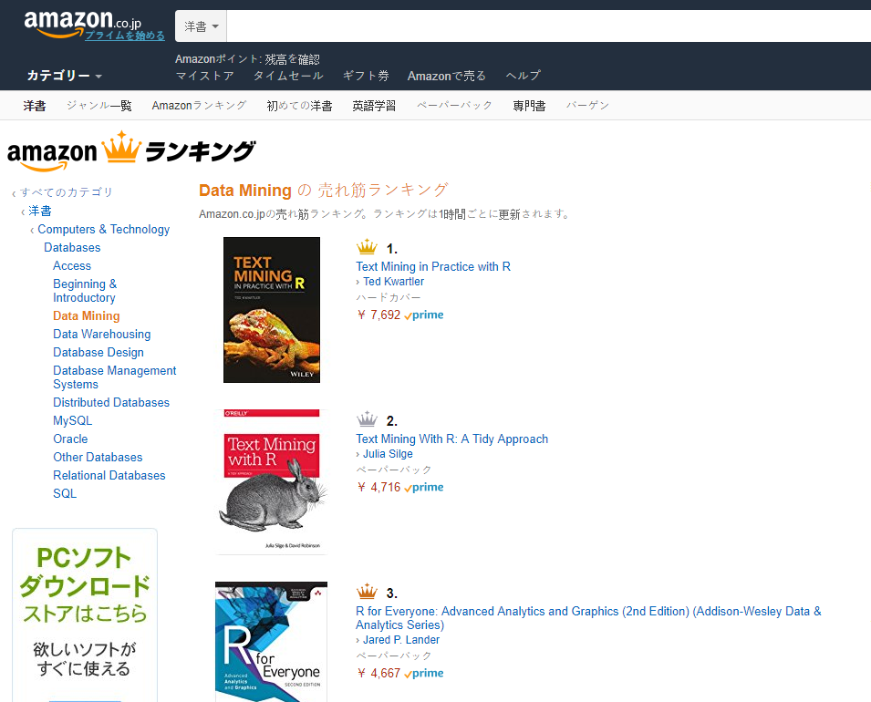

Shameless Plug #1

Slide 5
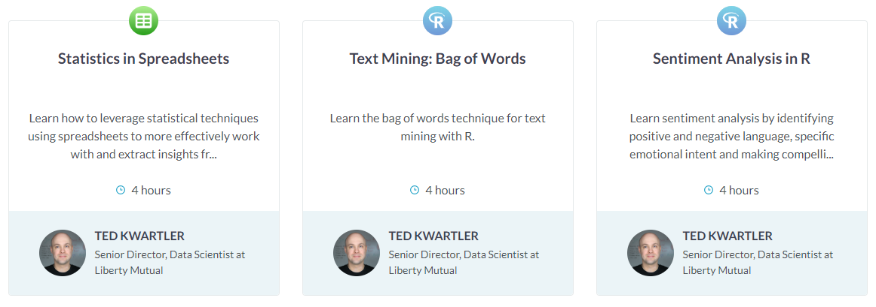

Shameless Plug #2*
*Both text courses are really covered in this course.

Slide 6
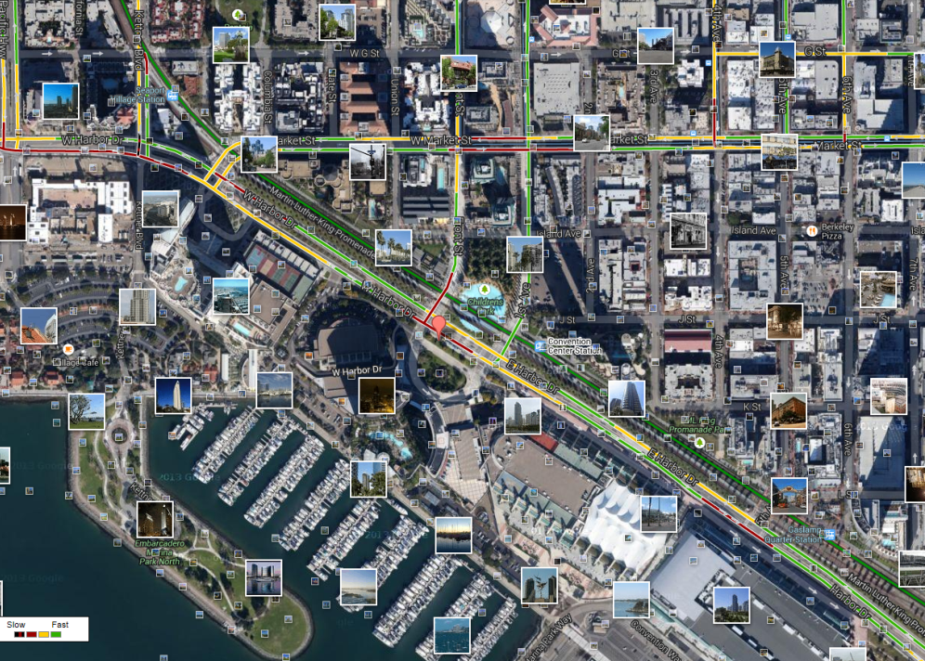
What is Text Mining?
Before Text Mining
Extract new insights from text
Let’s you drink from a fire hose of information
Language is hard; many unsolved problems
Unstructured
Expression is individualistic
Multi-language/cultural implications

Slide 7
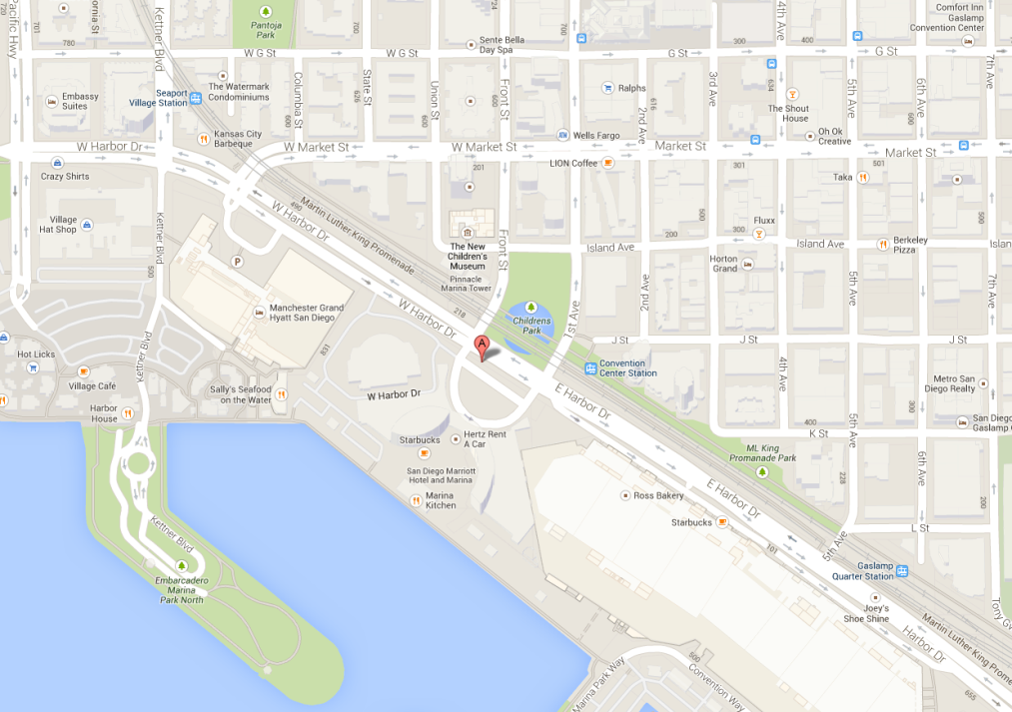
What is Text Mining?
After Text Mining
Extract new insights from text
Let’s you drink from a fire hose of information
Language is hard; many unsolved problems
Unstructured
Expression is individualistic
Multi-language/cultural implications

Slide 8
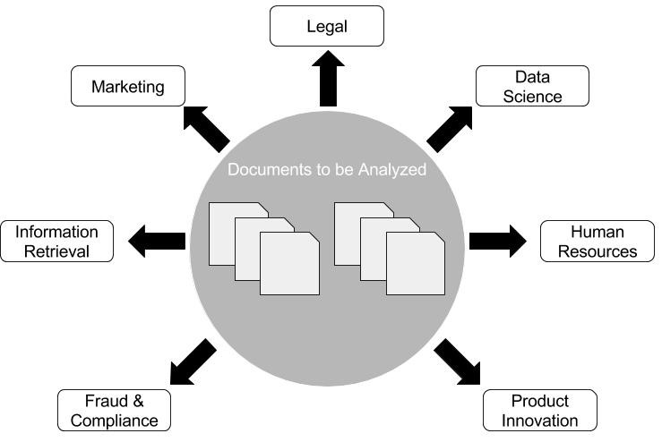
Where can NLP & Text Mining be used? Anywhere there are documents!

Slide 9
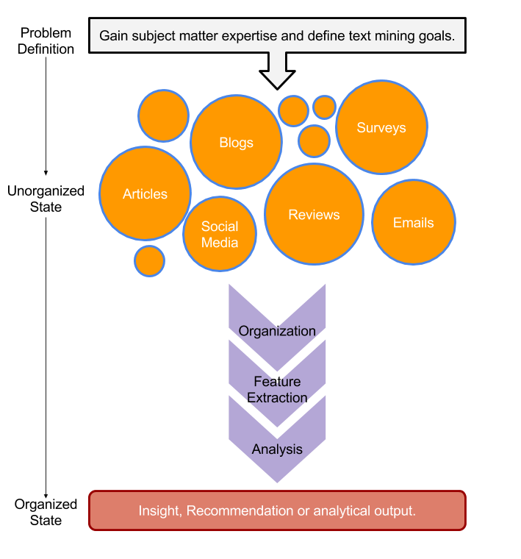
TM Project Workflow
Unorganized State
Natural Language Processing & Analysis
Organized State

Slide 10
Text Mining Workflow
Problem Definition
Identify Text Sources
Text Organization
Feature Extraction
Analytics
Reach Insight or Recommendation

Slide 11
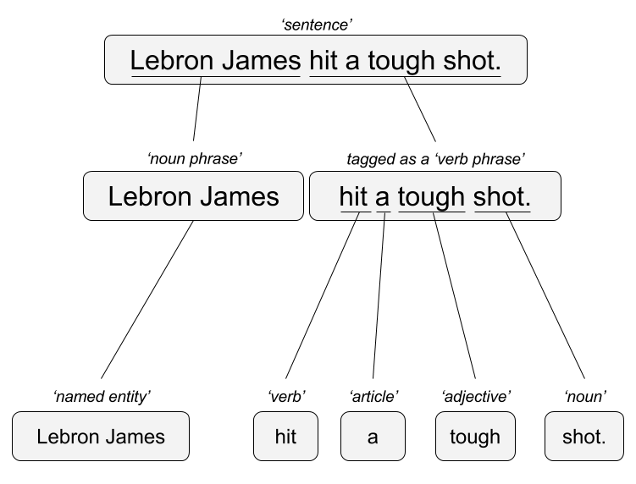

Two Popular Approaches
“Lebron James hit a tough shot.”
Syntactic Parsing
Bag of Words
Lebron
a
James
hit
tough
shot
*There are other approaches usually based on DNN, that I refer to “abstractive”

Slide 12


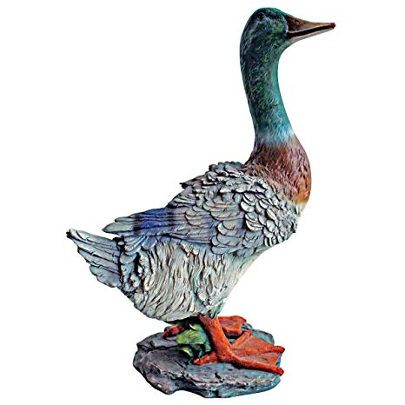
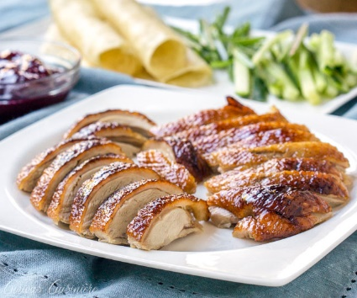
TM Challenges - Disambiguation
I made her duck.
I cooked waterfowl for her to eat.
I cooked waterfowl belonging to her.
I created the (clay?) duck and gave it to her.
Duck!!

Slide 13
TM Challenges - Misc
Other Challenges
Examples
Compound words (tokenization) change meaning
Sarcasm
Cultural differences
“Bad” vs “not bad”
“I like it…NOT!”
“It’s wicked good” (in Boston)

Slide 14





Why text mining is an art & science?
Challenges because human expression is diverse, often ambiguous, affected by age, demographics, socio-economics, medium/channel & regional attributes of the author.
Common Sources
Source & context are important, directly impacting data integrity.
Books
Electronic Docs (PDFs)
Blogs
Websites
Social Media
Customer Records
Customer Service Notes
Notes
Emails
Legal Documents
…

Slide 15



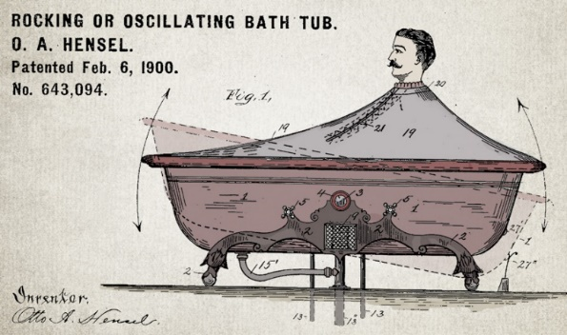


Channel affects language
Legal documents are verbose & technical.
“Be the change you want to see in the world.”
“kappa” indicates sarcasm, irony,
or a joke among online gamers.
Expression is context specific making analysis challenging.

Slide 16
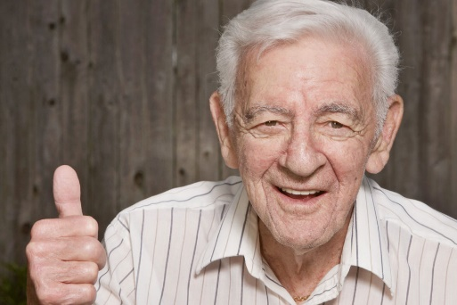


Messenger affects language
Boomers 1946-1964
* Make a difference * Consensus/team * Experiment/try new things * “Imagine if…” * Save time * Features and benefits
Gen X 1965-1980
Best, finest, world-class
“You will benefit by…”
”This is in your best interest.”
Gen Y 1981-2000
Global citizen
Balance
Diversity
Community/connections
Beyond generation, other factors like socio-economic, gender & demographic makeup impact expression.
https://www.anneloehr.com/

Slide 17


Gen Y/Z expression is evolving rapidly due to technology.
“Thank you, next.”
“Woke”
“Cray”
“Gucci”
“Squad goal”
“Bible…”
“Adulting”
“Turnt”
“Hundo P”
“Trill”
“TFW”
Beyond generation, other factors like socio-economic, gender & demographic makeup impact expression.

Slide 18
Gen Y/Z expression is evolving rapidly due to technology.
“Thank you, next.” – moving on with positive connotation
“Woke” - The more woke one is, the more sympathetic & knowledgeable one is about a topic or type of person
“Cray” - crazy
“Gucci” – fine, good
“Squad goal” – friend group behavior
“Bible…” - what follows is TRUTH
“Adulting” – activities associated with growing up
“Turnt” – “turned up” i.e. really excited
“Hundo P” – agree “100%”
“Trill” – True & Real
“TFW” – “That Feeling When” to describe an emotion
Beyond generation, other factors like socio-economic, gender & demographic makeup impact expression.

Slide 19


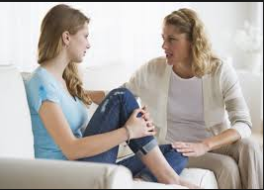

Audience affects language
And we all context switch based on who were are speaking too.

Slide 20

Warning: Twitter Profanity
Twitter demographics skew young and as a result have profanity that appear in the examples. “Keyboard Courage” is rampant.
It’s the easiest place to get a lot of messy text fast, if it is offensive feel free to talk to me and I will work to get you other texts for use on your own. No offense is intended.
#%@*!!!

Slide 21
Basic String Searching
Basic R Unix Commands
Setup
grepl returns a vector of T/F if the pattern is present at least once
grepl(“pattern”, searchable object, ignore.case=TRUE)
grep returns the position of the pattern in the document
grep(“pattern”, searchable object, ignore.case=TRUE)
“library(stringi)” Functions
stri_count counts the number of patterns in a document
stri_count(searchable object, fixed=“pattern”)

Slide 22

Coffee!!
Open C_String_Search_Manipulation
Learning Outcome: Start working with strings and related functions.

Slide 23
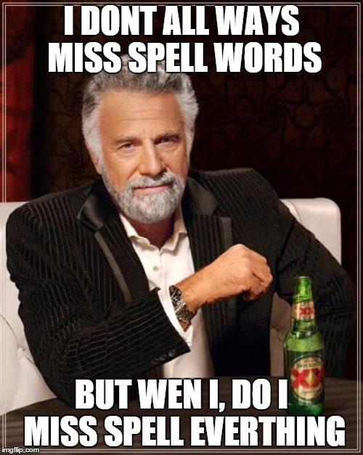
What about misspelling?
Prevalent
Painful to correct
Channel specific

Slide 24
R packages to deal with misspelling
library(qdap)
check_spelling(…)
check_spelling_interactive(…)
Crashes Rstudio.cloud!
Separate the words from a string into individual terms.
Look those words up in a dictionary to find words not recognized/found (considered possibly misspelled).
These misses (possible misspellings) will be what is looked up for suggested replacements and top “n” terms returns. It uses “string distance” the number of characters needed to change the unknown into the known word in the dictionary.

Slide 25
R packages to deal with misspelling
library(hunspell) #https://hunspell.github.io
hunspell_check(…)
hunspell_suggest(…)
hunspell_analyze(…)
Clunky to use!
Check the terms (doesn’t always catch the terms as well as qdap in my exp)
Identify the suggestions
No way to get suggestions easily corrected and inserted!
Same spelling engine used for Chrome/Firefox etc.

Slide 26
R packages to deal with misspelling
Library(spelling)
hunspell_check(…)
hunspell_suggest(…)
hunspell_analyze(…)
We will use in this course but pg 45 of the book has the qdap option
Check the terms
Identify the suggestions
Organize the suggestions into a lexicon
Use a global substitution (gsub) to correct identified mispellings
Still uses the benefit of hunspell but is easier to interact with.

Slide 27

Too much coffee!
Open D_spellCheck_examples.R
Learning Outcome: Identify and correct misspelled words in a text vector.

Slide 28
Agenda – all times are suggested
Start | End | Monday
8:45 | 9:15 | Coffee
9:15 | 10:15 | Syllabus, Intro to R, R Setup
10:15 | 10:30 | Break
10:30 | 12:00 | What is TM? String Manipulation Keyword Search & Density Misspelling
12:00 | 1:30 | Lunch
1:30 | 2:00 | Bag of Words tm Class & Functions Meta-Document Information
2:00 | 2:30 | WFM
2:30 | 3:15 | Lab: Clean a corpus of tweets & construct WFM

Slide 29
Remember This?

Slide 30

R for Cleaning Steps
Tomorrow I’m going to have a nice glass of Chardonnay and wind down with a good book in the corner of the county :-)
Remove Punctuation
Remove extra white space
Remove Numbers
Make Lower Case
Remove “stop” words
blogs
reviews
articles
tomorrow going nice glass chardonnay wind down good book corner county

Slide 31
Bag of Words Text Mining
“Lebron James hit a tough shot.”
Bag of Words
Information is extracted based on frequency or weighting. Steps are taken to aid aggregation.
Example Text Changes:
Capitalization
Coffee = coffee
Punctuation
shot. = shot
Numbers
One = 1 or removed
Stopwords
Remove non-informative terms ie “and” “the”
Lebron
a
James
hit
tough
shot

Slide 32

Library TM Functions
VCorpus creates a corpus held in memory.
VCorpus(source)
Document
Corpus
Corpora
Corpus- A collection of documents that analysis will be based on.
1/12/20
Kwartler CSCI -96
32

Slide 33
Corpora Examples
Hamlet
All Shakespearn Works
Shakespeare, Chaucer,
Alcott & Dickens
Intra-document
Analysis
Intra-subject
Comparative Analysis
Inter-subject/author
Comparative Analysis
1/12/20
Kwartler CSCI -96
33

Slide 34
Library TM Functions
VCorpus creates a corpus held in memory.
VCorpus(source)
tm_map applies the transformations for the cleaning
tm_map(corpus, function)
Corpus
tm_map(corpus, removePunctuation)
tm_map(corpus, stripWhitespace)
tm_map(corpus, removeNumbers)
tm_map(corpus, content_transformer(tolower))
tm_map(corpus, removeWords)
getTransformations() will list all standard tm corpus transformations.
content_transformer(Function) is needed to modify a corpus for non-tm package functions
1/12/20
Kwartler CSCI -96
34

Slide 35
Library qdap Functions
mgsub(“search pattern”, “replacement pattern”, text object)
replace_abbreviation()
replace_contraction()
replace_number() #1 to one
replace_ordinal() #1st to first
replace_symbol()
tm_map(corpus, content_transformer(replace_contractions))
tm_map(corpus, content_transformer(replace_abbreviation))
1/12/20
Kwartler CSCI -96
35

Slide 36
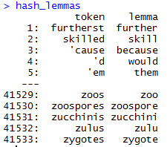
Poor Man’s Lemmatization (more to come later)
library(lexicon)
Qdap’s mgsub function can help you lemmatize words.
Bring in a lemmatization lexicon.
Supply a vector of patterns to search for
Supply a vector of patters to replace or change into.
Specify the vector the lexicon and substitutions should be applied to.
# Poor Man's Lemmatization
library(lexicon)
library(qdap)
data(hash_lemmas)
text$text <- mgsub(hash_lemmas$token,hash_lemmas$lemma,text$text)
Warning,: Not done in class because it takes a long time.

Slide 37
Custom Functions in this class
“tryTolower” is poached to account for errors when making lowercase.
tryTolower <- function(x){
# return NA when there is an error
y = NA
# tryCatch error
try_error = tryCatch(tolower(x), error = function(e) e)
# if not an error
if (!inherits(try_error, 'error'))
y = tolower(x)
return(y)}
Base: tolower (basic)
Stringr: str_to_lower (wrapper)
Custom: tryTolower (handles errors)

Slide 38
Custom Functions in this class
“cleanCorpus” is a convenience wrapper for basic cleaning operations
cleanCorpus<-function(corpus, customStopwords){
corpus <- tm_map(corpus, content_transformer(qdapRegex::rm_url))
corpus <- tm_map(corpus, removePunctuation)
corpus <- tm_map(corpus, stripWhitespace)
corpus <- tm_map(corpus, removeNumbers)
corpus <- tm_map(corpus, content_transformer(tryTolower))
corpus <- tm_map(corpus, removeWords, customStopwords)
return(corpus)
}

Slide 39
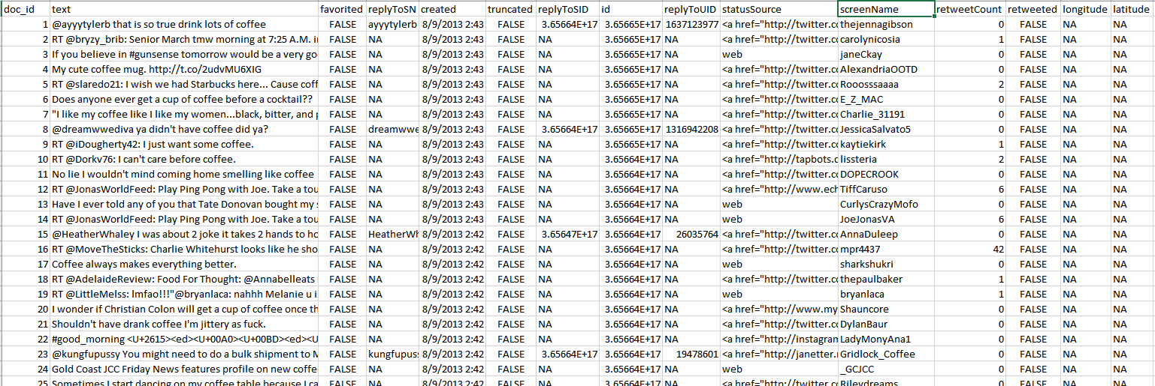
Meta Example
'$doc_id'
'$text'
META: $favorited, $created …
ID is for organization
Text is the information we want to examine
Meta adds context to our observations.

Slide 40
Nuances & Inputs for Setting Up a TM Project
“customStopwords” combines vectors of words to remove from the corpus
#Create custom stop words
customStopwords <- c(stopwords('english'), 'lol', 'smh')
Add channel specific stop words such as “lol” and “smh” for social media

Slide 41
Nuances & Inputs for Setting Up a TM Project
Retaining meta data information
# Data
text<-read.csv('coffee.csv', header=TRUE)
# As of tm version 0.7-3 tabular was deprecated
names(text)[1]<-'doc_id' #first 2 columns must be 'doc_id' & 'text'
txtCorpus <- VCorpus(DataframeSource(text))
txtCorpus <- cleanCorpus(txtCorpus)

Slide 42
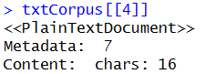
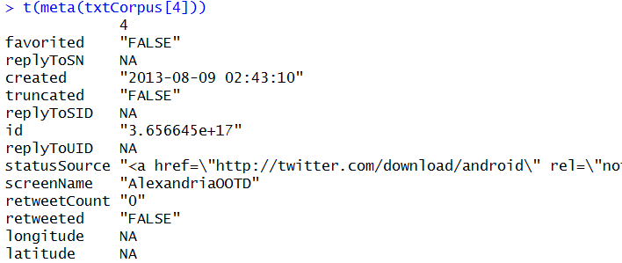
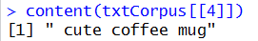
How do you retain meta information?
What is Meta?
What is content?
Meta information is data associated with the data you are analyzing. These can add context and allow you to partition data in insightful ways.
Timestamp (pre 9/11 Vs post 9/11)
Language (American Vs King’s English)
Author (Trump Vs Clinton)
Channel (Twitter Vs Legal Documents)
Content is simply the text (strings) you are analyzing. These data points represent the information of interest you are looking to gain insights from.
Retaining/Extracting Meta
Examining Content
SINGLE BRACKET
DOUBLE BRACKET
During an analysis it may be helpful to examine both meta & content information.

Slide 43
Bag of Words: TERM DOCUMENT MATRIX
Term Document Matrix
 | Tweet1 | Tweet2 | Tweet3 | Tweet4 | … | Tweet_n
Term1 | 0 | 0 | 0 | 0 | 0 | 0
Term2 | 1 | 1 | 0 | 0 | 0 | 0
Term3 | 1 | 0 | 0 | 2 | 0 | 0
… | 0 | 0 | 3 | 0 | 1 | 1
Term_n | 0 | 0 | 0 | 1 | 1 | 0
Code to Create the TDM and change to a matrix
txtDtm <- TermDocumentMatrix(txtCorpus)
txtDtmM <- as.matrix(txtDtm)
The matrices are sparse (many 0’s) so additional steps may be needed to extract information.

Slide 44
Bag of Words: DOCUMENT TERM MATRIX
Document Term Matrix
 | Term1 | Term2 | Term3 | … | Term_n
Tweet1 | 0 | 1 | 1 | 0 | 0
Tweet2 | 0 | 1 | 0 | 0 | 0
Tweet3 | 0 | 0 | 0 | 3 | 0
… | 0 | 0 | 0 | 1 | 1
Tweet_n | 0 | 0 | 0 | 1 | 0
Code to Create the DTM and change to a matrix
txtTdm <- DocumentTermMatrix(txtCorpus)
txtTdmM <- as.matrix(txtTdm)
The matrices are sparse (many 0’s) so additional steps may be needed to extract information.

Slide 45
Once cleaned, let’s get word frequencies.
beerFreq<-rowSums(beerTDMm)
beerFreq<-data.frame(word=names(beerFreq),frequency=beerFreq)
Term Document Matrix
Word Frequency Matrix
 | Tweet1 | Tweet2 | Tweet3 | Tweet4 | … | Tweet_n
Term1 | 0 | 0 | 0 | 0 | 0 | 0
Term2 | 1 | 1 | 0 | 0 | 0 | 0
Term3 | 1 | 0 | 0 | 2 | 0 | 0
… | 0 | 0 | 3 | 0 | 1 | 1
Term_n | 0 | 0 | 0 | 1 | 1 | 0
word | freq
Term1 | 0
Term2 | 2
Term3 | 3
… | 5
Term_n | 2

Slide 46
What about a DTM?
beerFreq<-???????(beerDTMm)
beerFreq<-data.frame(word=names(beerFreq),frequency=beerFreq)
Document Term Matrix
Word Frequency Matrix
 | Term1 | Term2 | Term3 | … | Term_n
Tweet1 | 0 | 1 | 1 | 0 | 0
Tweet2 | 0 | 1 | 0 | 0 | 0
Tweet3 | 0 | 0 | 0 | 3 | 0
… | 0 | 0 | 0 | 1 | 1
Tweet_n | 0 | 0 | 0 | 1 | 0
word | freq
Term1 | 0
Term2 | 2
Term3 | 3
… | 5
Term_n | 2
Can anyone think of how you could get a DTM to be a WFM?

Slide 47
Let’s practice! Open E_text_organization.R
Why are these matrices sparse? What do they represent?
In a Document Term Matrix what is each row?
In a Term Document Matrix what is each row?
Code to Create the DTM/ and change to a matrix
txtDTM <- DocumentTermMatrix(txtCorpus)
txtTDM <- TermDocumentMatrix(txtCorpus)

Slide 48
Agenda – all times are suggested
Start | End | Monday
8:45 | 9:15 | Coffee
9:15 | 10:15 | Syllabus, Intro to R, R Setup
10:15 | 10:30 | Break
10:30 | 12:00 | What is TM? String Manipulation Keyword Search & Density Misspelling
12:00 | 1:30 | Lunch
1:30 | 2:00 | Bag of Words tm Class & Functions Meta-Document Information
2:00 | 2:30 | WFM
2:30 | 3:15 | Lab: Clean a corpus of tweets & construct WFM

Slide 49
Lab/Homework
15Min : Clean and create a DTM & TDM for one of the other tweet CSVs:
Game of Thrones
Game of Thrones Finale
Coffee_May19
15Min: Review Chapter 2 & today’s scripts: Come with questions in the AM
30Min: Read Chapter 3 of Text Mining in Practice w/R

